Slide 1



Object-Oriented Programming with C#
Classes, Constructors, Properties, Static Members, Interfaces, Inheritance, Polymorphism

Slide 2


Access Modifiers
Public, Private, Protected, Internal,
Protected Internal

Slide 3
Access Modifiers
Class members can have access modifiers
Used to restrict the classes able to access them
Class members can be:
public
protected
Private
internal
Protected internal

Slide 4
Public
Public members are accessible anywhere,
inside the type (e.g. - class),
outside the type,
inside the assembly,
outside the assembly,
through the inheritance or with the type

Slide 5
Private and protected
Private members are only accessible within the own type (Own class).
Protected member are accessible only with its derived types whether it is inside the assembly or outside the assembly.

Slide 6
Internal and protected internal
Internal member are accessible only within the assembly by inheritance (its derived type) or by instance of class.
protected internal
Protected Internal Property = Protected Property (anywhere in its derived class inside or outside the assembly)+ Internal (with instance of class only inside the assembly)

Slide 7
Protected Internal
Protected internal is type of access modifier contains protected member properties as well as internal member properties,
means protected internal member accessible inside the assembly in its derived class or with the instance of the class
and accessible outside the class only in its derived class.

Slide 8
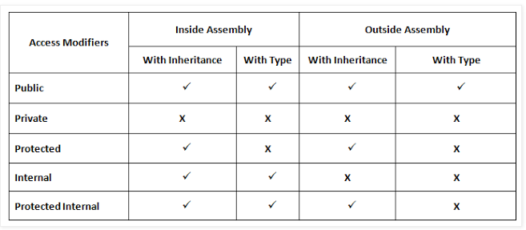

Slide 9
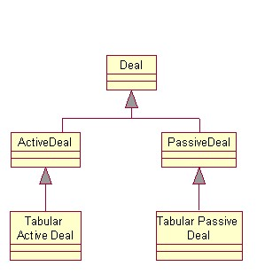
Inheritance

Slide 10
Inheritance
Inheritance refers to the process of deriving new classes from existing classes
Inheritance enables code reusability
The class whose methods are inherited is called base (parent) class
The class that gains new functionality is called derived (child) class
Derived class has all the features of base class and also its own features

Slide 11
Inheritance – Points to note
All class members are inherited(non private )
Fields, methods, properties, …
In C# classes could be inherited
The structures in C# could not be inherited
In .NET there is no multiple inheritance, except when implementing interfaces

Slide 12
How to Define Inheritance?
We must specify the name of the base class after the name of the derived
In the constructor of the derived class we use the keyword base to invoke the constructor of the base class
public class Shape
{...}
public class Circle : Shape
{...}
public Circle (int x, int y) : base(x)
{...}

Slide 13

Inheritance – Example
public class Mammal
{
private int age;
public Mammal(int age)
{
this.age = age;
}
public int Age
{
get { return age; }
set { age = value; }
}
public void Sleep()
{
Console.WriteLine("Shhh! I'm sleeping!");
}
}

Slide 14

Inheritance – Example (2)
public class Dog : Mammal
{
private string breed;
public Dog(int age, string breed): base(age)
{
this.breed = breed;
}
public string Breed
{
get { return breed; }
set { breed = value; }
}
public void WagTail()
{
Console.WriteLine("Tail wagging...");
}
}

Slide 15

Inheritance – Example (3)
static void Main()
{
// Create 5 years old mammal
Mamal mamal = new Mamal(5);
Console.WriteLine(mamal.Age);
mamal.Sleep();
// Create a bulldog, 3 years old
Dog dog = new Dog("Bulldog", 3);
dog.Sleep();
dog.Age = 4;
Console.WriteLine("Age: {0}", dog.Age);
Console.WriteLine("Breed: {0}", dog.Breed);
dog.WagTail();
}

Slide 16
Classification of Inheritance
Single Inheritance
Hierarchical Inheritance
Multi Level Inheritance
Hybrid Inheritance
Multiple Inheritance

Slide 17
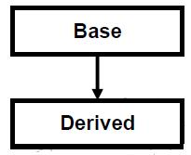
Single Inheritance
when a single derived class is created from a single base class then the inheritance is called as single inheritance.

Slide 18
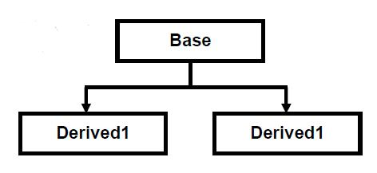
Hierarchical Inheritance
when more than one derived class are created from a single base class, then that inheritance is called as hierarchical inheritance.

Slide 19
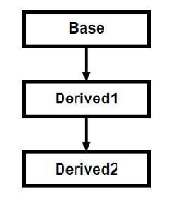
Multi Level Inheritance
when a derived class is created from another derived class, then that inheritance is called as multi level inheritance.

Slide 20
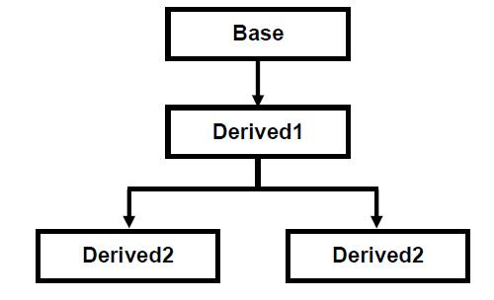
Hybrid Inheritance
Any combination of single, hierarchical and multi level inheritances is called as hybrid inheritance.

Slide 21
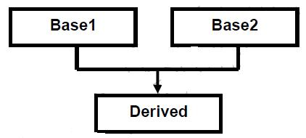
Multiple Inheritance
when a derived class is created from more than one base class then that inheritance is called as multiple inheritance. But multiple inheritance is not supported by .net using classes and can be done using interfaces

